Slide 1
Alpha Kappa Alpha Sorority, Incorporated
Sigma Epsilon Omega Chapter
Warner Robins, Georgia

Slide 2
Sigma Epsilon Omega Chapter
Chartered – January 27, 1990
2011 Chapter Facts
78 Members
17 Charter Members
1 Golden Girl
37 Sliver Stars
13 Life Members

Slide 4
2011
Golden and Silver Member
Tribute

Slide 5
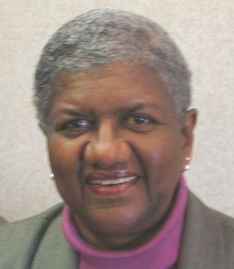
Golden Girl (50+ Years) Evelyn Siler
Initiated
February 1953
Alpha Chi Chapter
North Carolina Central University

Slide 6
Silver Stars
(25 + Years of Membership)

Slide 7
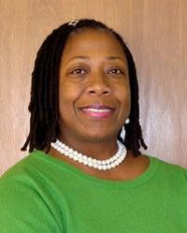
LaTanga Allen-Felder
Initiated
November 1981
Gamma Upsilon Chapter
Savannah State University

Slide 8
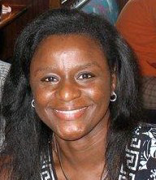
Charlie Arnold
Initiated
Spring 1983
Gamma Phi Chapter
Alcorn State University

Slide 9
Tamela Brown
Initiated
March 1984
Beta Pi Chapter
Alabama State University

Slide 10
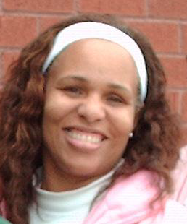
Ramona Chapman
Initiated
May 1980
Zeta Eta Chapter
Paine College

Slide 11
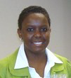
Tammy Dunn
Initiated
March 1986
Alpha Beta Chapter
Fort Valley State University

Slide 12
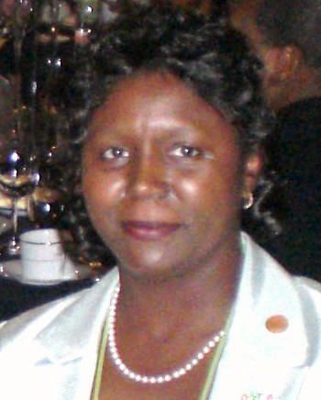
Cassie Ferguson
Initiated
December 1975
Iota Pi Chapter
Baptist College (SC)

Slide 13
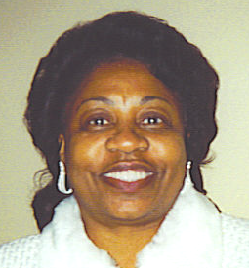
Tiena Fletcher
Initiated
October 1980
Gamma Pi Omega Chapter
Fort Valley, GA

Slide 14
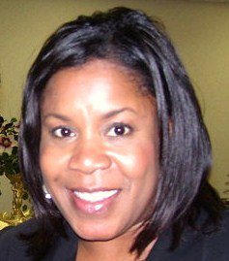
Angela McKinney Grant
Initiated
November 1984
Alpha Beta Chapter
Fort Valley State University

Slide 15
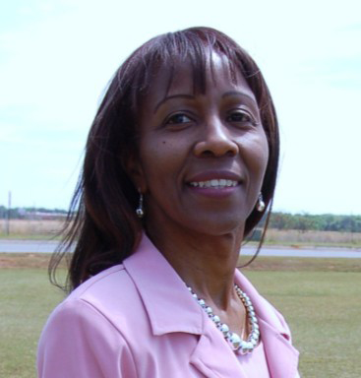
Patricia Grover-Lockhart
Initiated
November 1978
Alpha Beta Chapter
Fort Valley State University

Slide 16
Melvese Harris
Initiated
May 1981
Gamma Sigma Chapter
Albany State University

Slide 17
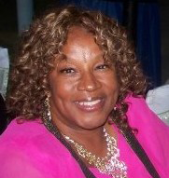
Yolanda Hart
Initiated
May 1975
Eta Iota Chapter
Columbus State University

Slide 18
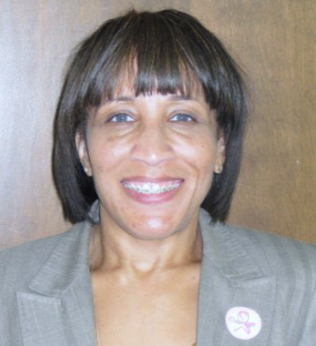
Aretha Hill
Initiated
March 1986
Alpha Beta Chapter
Fort Valley State University

Slide 19
Kathy Hill
Initiated
May 1969
Alpha Beta Chapter
Fort Valley State University

Slide 20
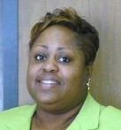
Lori Hill
Initiated
December 1985
Gamma Beta Chapter
University of Nebraska-Omaha

Slide 21
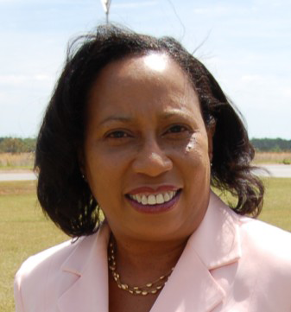
Elaine Holmes
Initiated
October 1980
Gamma Pi Omega Chapter
Fort Valley, GA

Slide 22
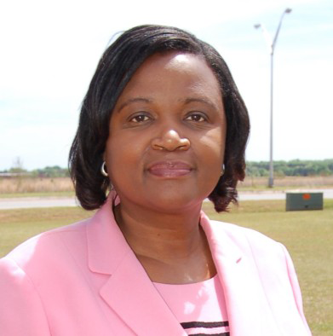
Brenda Hopson
Initiated
November 1975
Gamma Sigma Chapter
Albany State University

Slide 23
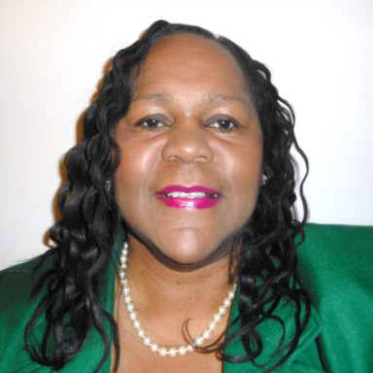
Carolyn Jackson
Initiated
May 1977
Gamma Sigma Chapter
Albany State University

Slide 24
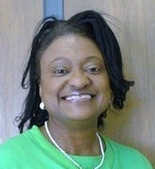
Shirlyn Johnson-Granville
Initiated
November 1980
Pi Chapter
Fisk University

Slide 25
Cynthia Kirk
Initiated
March 1981
Gamma Mu Chapter
Alabama A & M University

Slide 26
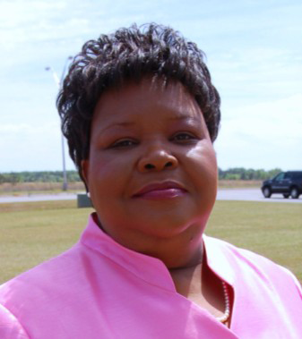
Felicia Meadows
Initiated
November 1975
Gamma Sigma Chapter
Albany State University

Slide 27
Florence Mitchell
Initiated
May 1972
Gamma Pi Omega Chapter
Fort Valley, GA

Slide 28
Francis Pierson
Initiated
October 1984
Eta Chi Chapter
Northwestern State University

Slide 29
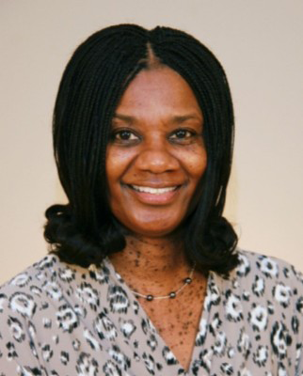
Violet Poe
Initiated
November 1980
Pi Chapter
Fisk University

Slide 30
Birdie Pogue
Initiated
May 1970
Beta Pi Chapter
Alabama State University

Slide 31
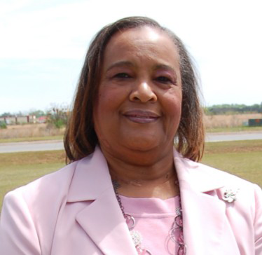
Christine Porter
Initiated
June 1983
Gamma Pi Omega Chapter
Fort Valley, GA

Slide 32
Paulette Rachel
Initiated
February 1974
Zeta Lambda Chapter
University of Tennessee - Martin

Slide 33
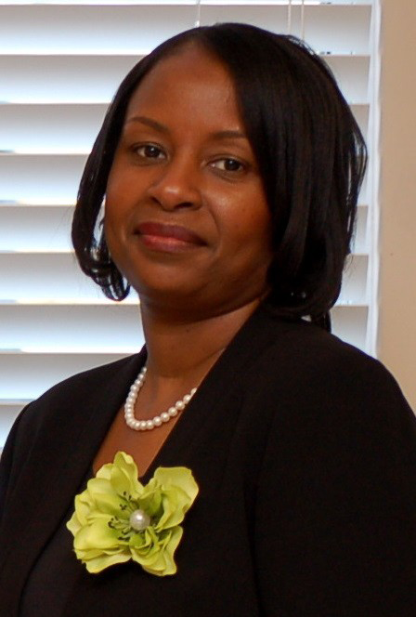
Adrienne Ray
Initiated
April 1985
Beta Sigma Chapter
South Carolina State University

Slide 34
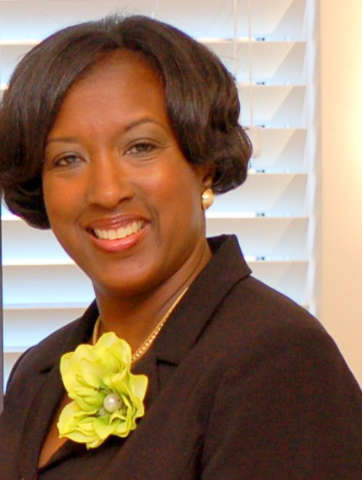
Renee Brown Reese
Initiated
November 1978
Gamma Kappa Chapter
Tuskegee University

Slide 35
Arleen Brown Samuels
Initiated
May 1981
Gamma Sigma Chapter
Albany State University

Slide 36
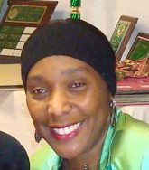
Jaki Scott
Initiated
April 1975
Gamma Kappa Chapter
Tuskegee University

Slide 37
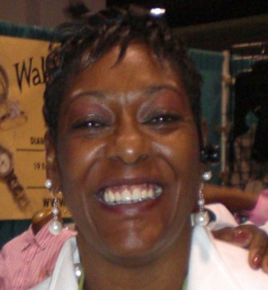
Romelda Simmons
Initiated
December 1982
Pi Chapter
Fisk University

Slide 38
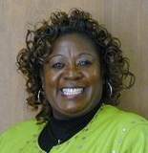
Mable Solomon
Initiated
May 1977
Gamma Sigma Chapter
Albany State University

Slide 39
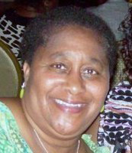
Theodora Springle
Initiated
May 1977
Alpha Beta Chapter
Fort Valley State University

Slide 40
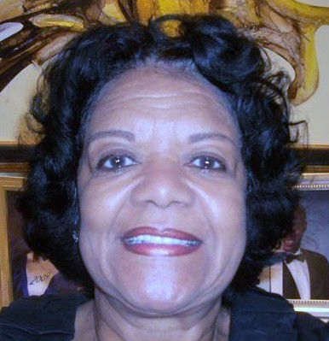
Earline Stewart
Initiated
March 1984
Xi Mu Omega Chapter
Columbia, MS

Slide 41
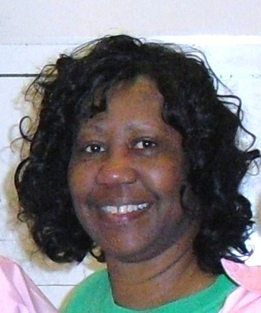
Tanya Swygert
Initiated
May 1975
Eta Lambda Chapter
California State University

Slide 42
Rose Taylor
Initiated
1981
Delta Epsilon Chapter
Norfolk State University

Slide 43
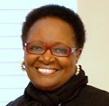
Trelley Williams
Initiated
May 1986
Gamma Pi Omega Chapter
Fort Valley, GA

Slide 44
