Slide 1
2011
South Atlantic
Regional Conference

Slide 2


Slide 3


Slide 4
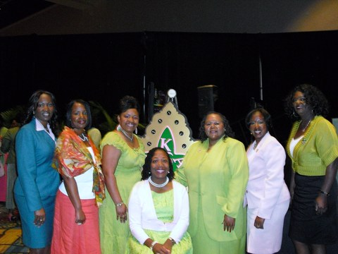

Slide 5


Slide 6
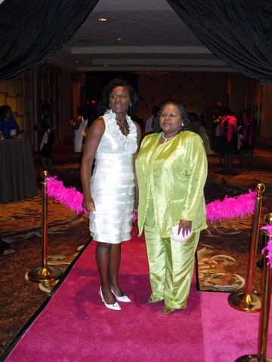

Slide 7


Slide 8


